Slide 1

Predictive Modelling Using Decision Tree For Low Birth Weight Infants

Slide 2
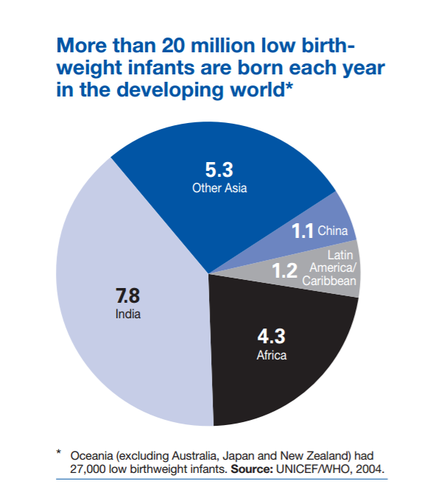

Slide 3
Reasons Behind Low Birth Weight
Age of Parents
Education of Parents
Marital Status
Health Condition of Mother
Behavior of Parents
Total Number of Pregnancies……

Slide 4
Exploratory Data Analysis
Predictor Variables
37
Nominal Variables
21
Interval Variables
13
Binary Variables
3

Slide 5
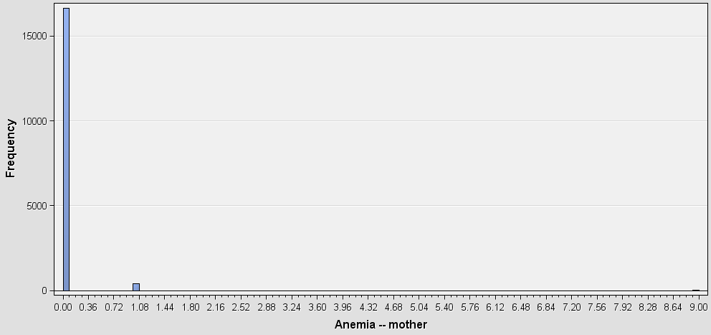
Exploratory Data Analysis

Slide 6
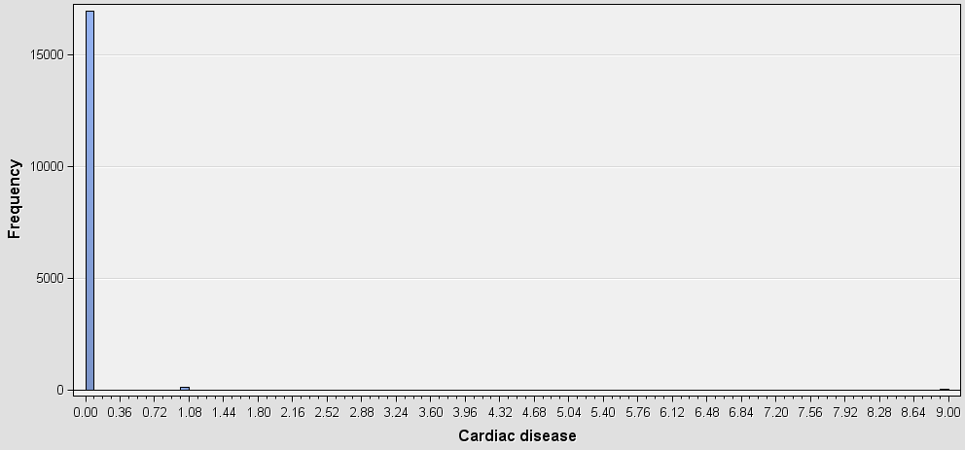
Exploratory Data Analysis

Slide 7
Response Variable
Low Birth Weight
0= Normal Weight
1= Low Birth Weight

Slide 8
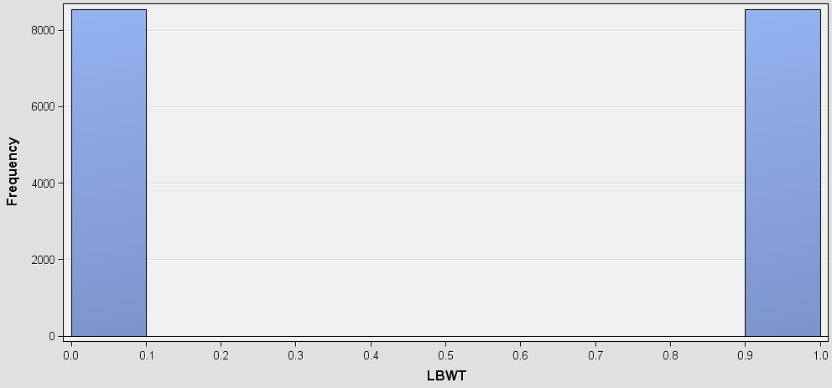
Response Variable

Slide 9
Data Split
Total Number of Observations
17,097
Training Data
50%
Validation Data
50%

Slide 10
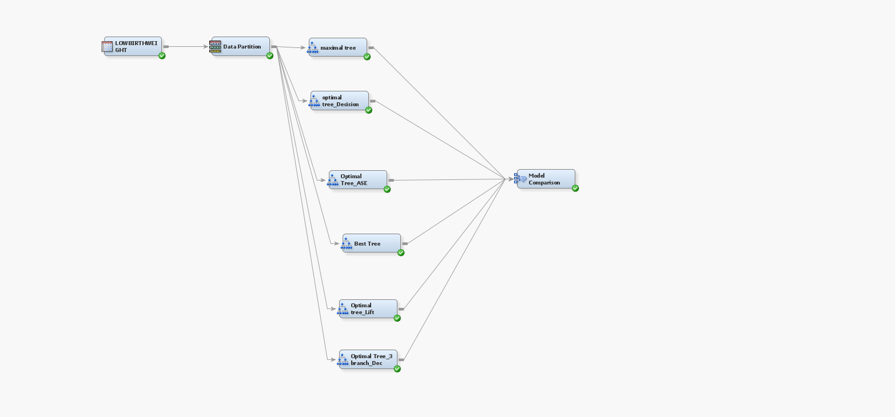
Data Modelling

Slide 11
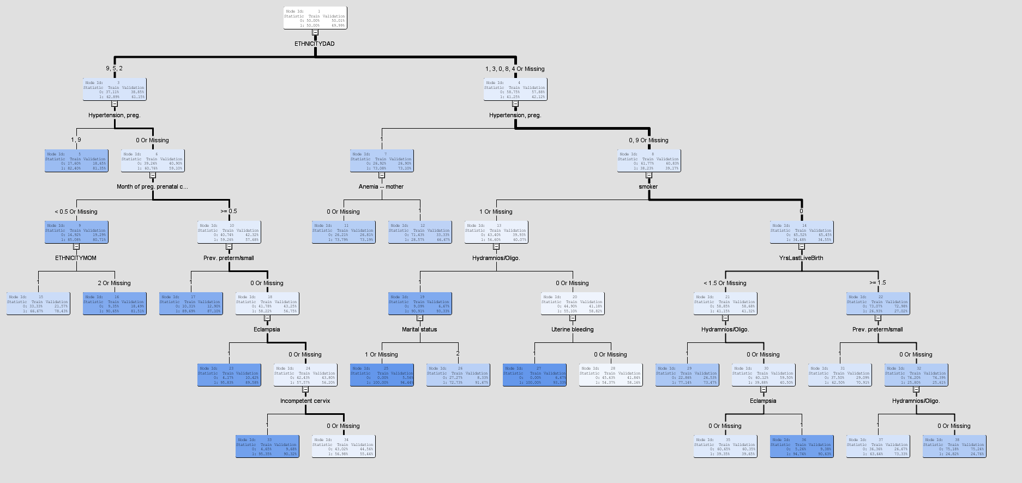
Maximal Tree

Slide 12
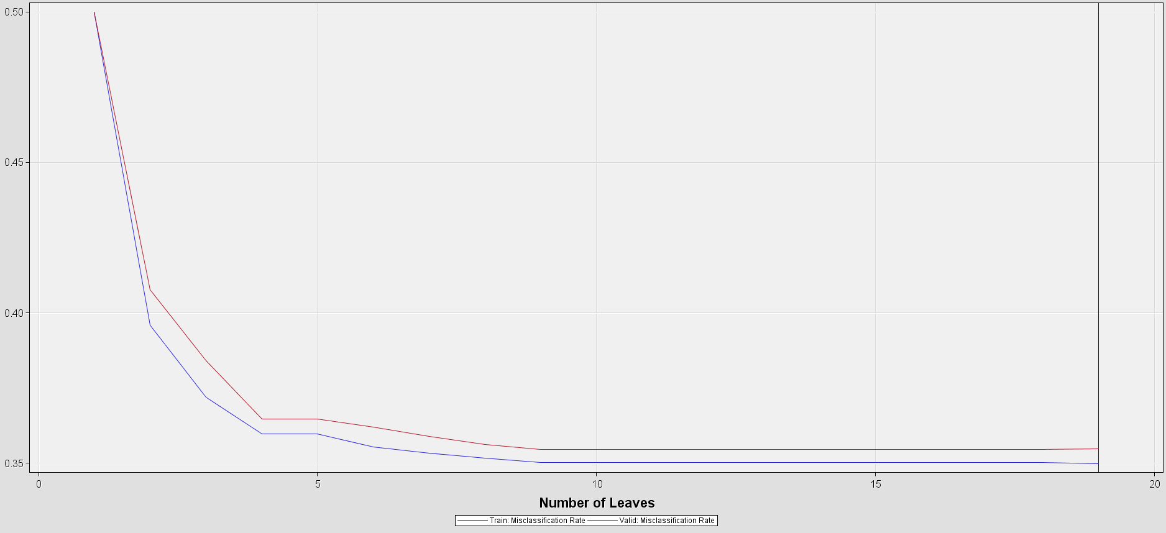
Subtree Assessment Plot

Slide 13
Model Comparison
Name of the decision tree | Validation Misclassification Rate | Validation Average Square Error
maximal tree | 0.354778337 | 0.219609526
Optimal Tree_ASE | 0.354544391 | 0.219277658
Optimal tree_Lift | 0.354544391 | 0.219277658
Optimal Tree_3 branch_Dec | 0.355714119 | 0.225566637
optimal tree_Decision | 0.354544391 | 0.225136369
Optimal tree_Missclass | 0.354544391 | 0.225136369

Slide 14
Model Comparison
Name of the decision tree | Number of Leaves
maximal tree | 19
Optimal Tree_ASE | 16
Optimal tree_Lift | 16
Optimal Tree_3 branch_Dec | 12
optimal tree_Decision | 9
Optimal tree_Missclass | 9

Slide 15
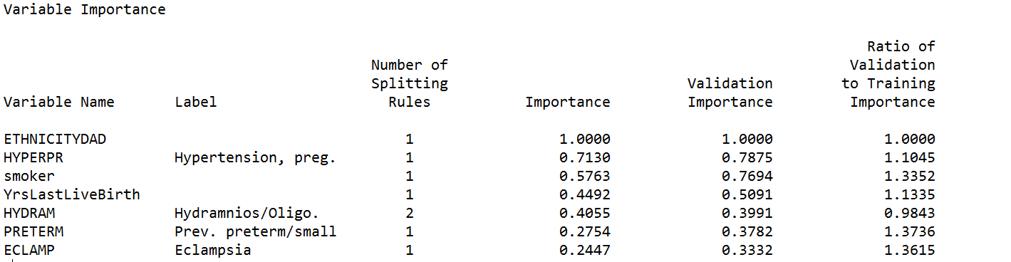
Variables of Best Model

Slide 16
Fit Statistics ( Validation Data Set)
Misclassification Rate
35.45%
Average Squared Error
0.22
Terminal Leaf
09

Slide 17
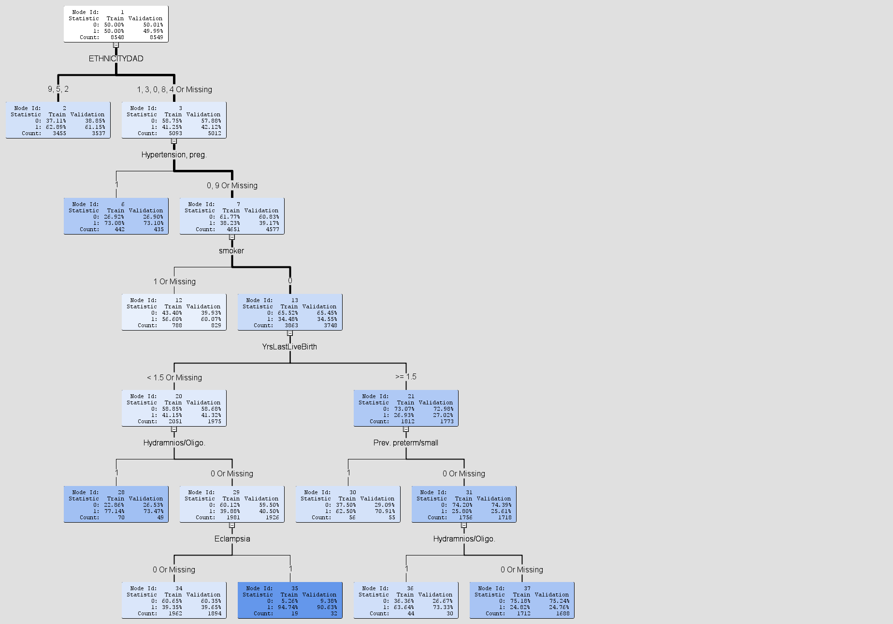
Decision Tree

